Slide 1
Refresh your retirement plans and stay on track
July 2024
Notes:
Reference 24031800

Slide 2
Today’s speakers
Who we are and what we do
Malcolm Robinson
Ricky Wilson
Partner
Chartered Financial Planner
Evelyn Partners Financial Planning Limited
Evelyn Partners Financial Planning Limited
malcolm.robinson@evelyn.com
Ricky.wilson@evelyn.com
Notes:
Opening
Introductions
Evelyn Partners

Slide 3
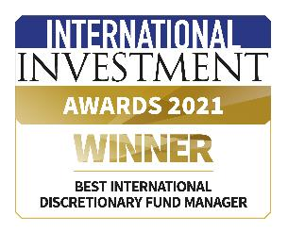
About Evelyn Partners
Who we are and what we do
1
187 YEARS
179k+
£59.1bn
10+
of the leading wealth management groups
of helping clients achieve their financial goals
clients trust us with their financial future
assets under management
Years Performance track record
A leading
3000
30
290+
330+
provider of investment and financial advisory services
>3,000 staff across the UK, Ireland and Jersey
Qualified financial planners
Investment managers
local offices
Financial Planning Awards
Investment Awards
As at 31 December 2023
Past performance is not a guide to future performance
Notes:
Guidance: This version introduces the group, suitable for accountants. Compliance number: 22065812

Slide 4
What we’ll cover
welcome
1
Retirement planning considerations
2
Pensions and point of retirement options
3
Benefits of financial forecasting
4
Managing investment risk in retirement
5
Effective use of tax allowances
6
Questions

Slide 5
Positioning yourself for retirement

Slide 6
Managing changing priorities
Positioning Yourself for Retirement
Draw income
Pay for care
Access cash
Plan to pass it on
20s
30s
40s
50s
60s
70s
80s
90s
Pay in
Secure income
50s
60s
70s
80s
90s
Notes:
Retirement is a journey over many years and what is right for someone in their 60’s may well not be by the time they get to their 80’s.
Ongoing advice through the various stages of retirement to ensure that the right decisions are made at the right time will be imperative.
Investments and their performance should also be frequently assessed
For example, as you approach retirement, it could make sense to switch more of your investments into safer, more secure assets
We recommend that you review your retirement plan every year with a highly-qualified financial planner.

Slide 7
Preparing for retirement - options
Positioning Yourself for Retirement
SAVE
OSTRICH
NEVER RETIRE
LOTTERY
INHERITANCE
DOWNSIZE
SELL BUSINESS
Notes:
Guidance: Get the client to think about the questions they need to be asking themselves. This is about identifying the need for help – not providing all the answers and solutions right here. Ask open ended questions.
Questions on the slide are open questions to help with dialogue. Additional questions you may suggest they think about are:
When can I retire, can it be earlier if I want to?
How much do I need for my future and where will this come from?
Am I investing enough?
Are my finances structured with maximum tax-efficiency?
Am I close to the Lifetime allowance?
Am I using all my allowances?
Can I afford to help my family without compromising my retirement choices?
Am I set to leave an inheritance tax bill for my family?
Will I be able to afford long-term care if I need it?
How comfortable would you be with answering these questions yourself?

Slide 8
Don’t just rely on your pension
Positioning Yourself for Retirement
Questions that you need to think about
When do I want to retire?
What do I plan to do in my retirement?
Do I know how much that would cost?
What would a comfortable retirement look like?
How much help do I think my children will need in the future?
Do I expect to retire completely, or will it be more gradual?
How do I think my expenditure will change in retirement?
Notes:
Guidance: Get the client to think about the questions they need to be asking themselves. This is about identifying the need for help – not providing all the answers and solutions right here. Ask open ended questions.
Questions on the slide are open questions to help with dialogue. Additional questions you may suggest they think about are:
When can I retire, can it be earlier if I want to?
How much do I need for my future and where will this come from?
Am I investing enough?
Are my finances structured with maximum tax-efficiency?
Am I close to the Lifetime allowance?
Am I using all my allowances?
Can I afford to help my family without compromising my retirement choices?
Am I set to leave an inheritance tax bill for my family?
Will I be able to afford long-term care if I need it?
How comfortable would you be with answering these questions yourself?

Slide 9
How much income do I need?
Positioning Yourself for Retirement
Standard of living | Single person | Couple
Basic | £14,400 PA | £22,400 PA
Moderate | £31,300 PA | £43,100 PA
Comfortable | £43,100 PA | £59,000 PA
The three levels show the amount you might need to achieve that standard of living in retirement. Everyone's financial circumstances are different. The standards provide a rule of thumb guide based on common costs for many people in retirement.
Source: Pensions & Lifetime Savings Association, www.retirementlivingstandards.org.uk, January 2024

Slide 10
What size fund do I need?
Positioning Yourself for Retirement
Standard of living | Single person | State pension | Gross income shortfall | Fund size required if annuity purchase (*7th March)
Basic | £14,400 PA | £11,502 PA | £3,355 PA | £45,338
Moderate | £31,300 PA | £11,502 PA | £24,480 PA | £330,810
Comfortable | £43,100 PA | £11,502 PA | £39,284 PA | £530,884
For illustrative purposes only. The actual fund size needed depends on individual circumstances and could be more or less than this amount
The three levels show the amount you might need to achieve that standard of living in retirement. Everyone's financial circumstances are different. The standards provide a rule of thumb guide based on common costs for many people in retirement.
Source: Pensions & Lifetime Savings Association, www.retirementlivingstandards.org.uk, January 2024 Assumes annuity rate of 7.4% - example only - (single life, level annuity, age 66 -*7th March 2024 )

Slide 11
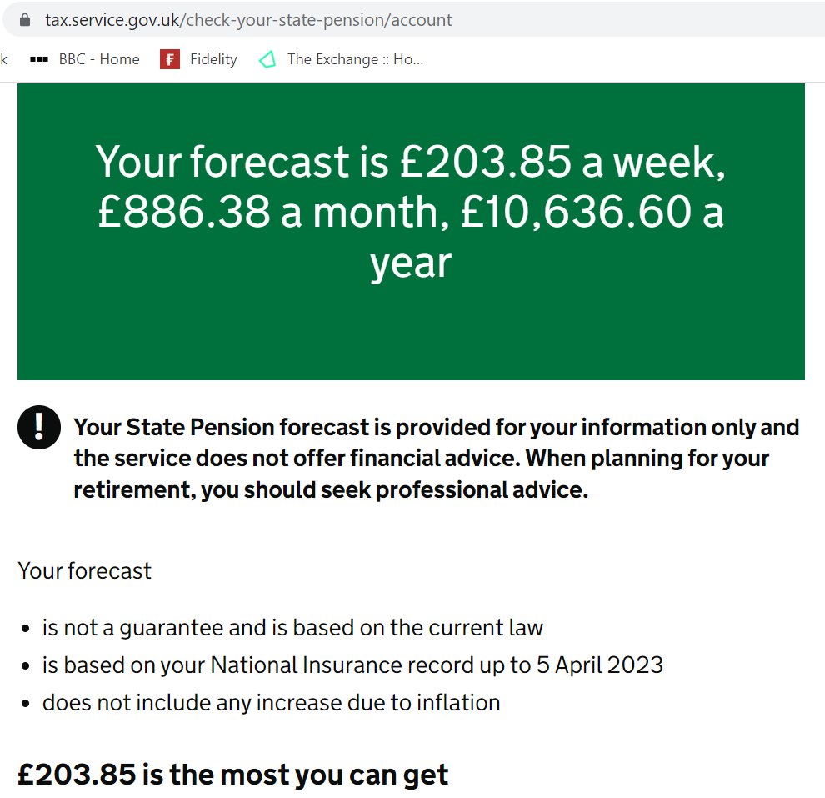
State Pension
Positioning Yourself for Retirement
Introduced in 1909
New flat rate State Pension introduced in 2016
Some will have additional entitlements
35 years of NI contributions now required for full pension
Less than 10 years = no entitlement
Can make voluntary contributions
Check your entitlement via Government Gateway
For illustrative purposes only.
Source tracking link https://www.access.service.gov.uk/login/signin/creds
Notes:
Guidance: Get the client to think about the questions they need to be asking themselves. This is about identifying the need for help – not providing all the answers and solutions right here. Ask open ended questions.
Questions on the slide are open questions to help with dialogue. Additional questions you may suggest they think about are:
When can I retire, can it be earlier if I want to?
How much do I need for my future and where will this come from?
Am I investing enough?
Are my finances structured with maximum tax-efficiency?
Am I close to the Lifetime allowance?
Am I using all my allowances?
Can I afford to help my family without compromising my retirement choices?
Am I set to leave an inheritance tax bill for my family?
Will I be able to afford long-term care if I need it?
How comfortable would you be with answering these questions yourself?

Slide 12
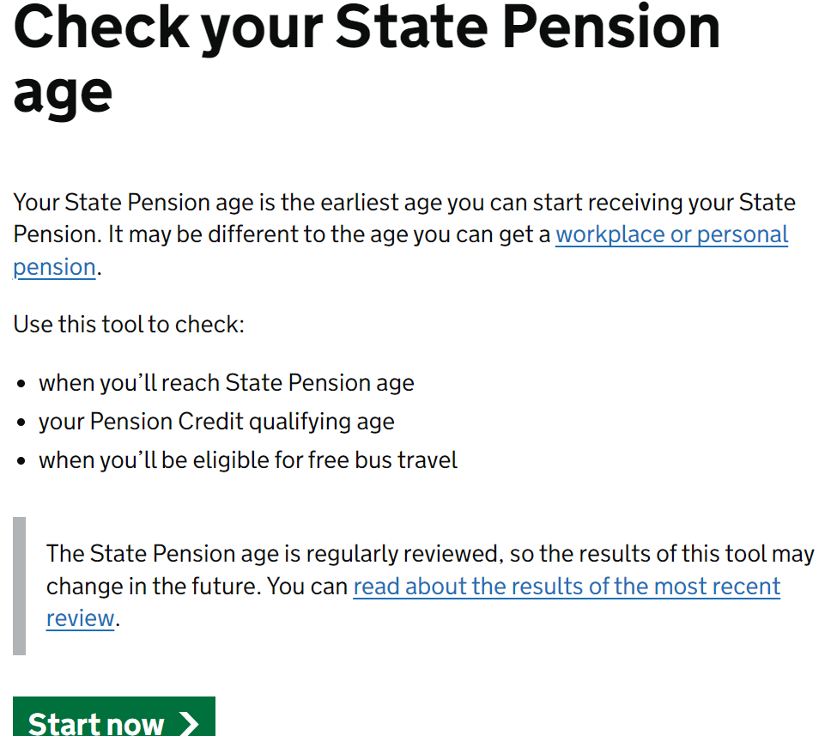
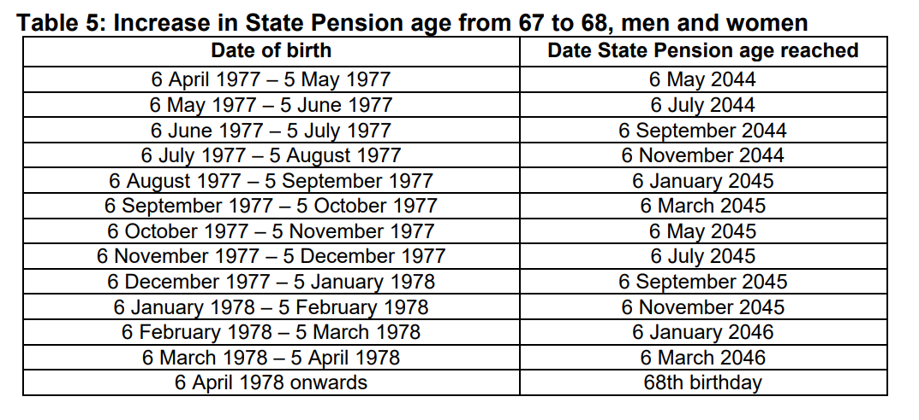
State Pension Age
Positioning Yourself for Retirement
Was 60 for women, 65 for men
Now 66 for anyone born before April 1960
67 for anyone born between April 1960 and April 1977
Rising to 68
Further increases?
State Pension age timetables (publishing.service.gov.uk)
https://assets.publishing.service.gov.uk/government/uploads/system/uploads/attachment_data/file/310231/spa-timetable.pdf
Source tracking link https://www.access.service.gov.uk/login/signin/creds
Notes:
Guidance: Get the client to think about the questions they need to be asking themselves. This is about identifying the need for help – not providing all the answers and solutions right here. Ask open ended questions.
Questions on the slide are open questions to help with dialogue. Additional questions you may suggest they think about are:
When can I retire, can it be earlier if I want to?
How much do I need for my future and where will this come from?
Am I investing enough?
Are my finances structured with maximum tax-efficiency?
Am I close to the Lifetime allowance?
Am I using all my allowances?
Can I afford to help my family without compromising my retirement choices?
Am I set to leave an inheritance tax bill for my family?
Will I be able to afford long-term care if I need it?
How comfortable would you be with answering these questions yourself?

Slide 13
Pensions have an important role to play
Positioning Yourself for Retirement
04
01
25% tax free lump sum**
Tax relief on contributions*
Pensions
03
02
Free from income and capital gains tax
Outside of estate for Inheritance tax (IHT)
Tax reliefs and allowances depend on individual circumstances and are subject to change *Contributions within the Annual Allowance. **Money Purchase pensions, if within the Lifetime Allowance. The amount of tax-free lump sum may vary.
Notes:
Explain why pensions are still a key priority for retirement planning, but…
… Pension Tax rules have reduced the amount you can hold in a pension before you incur a penal tax charge.
Lets look at this in more detail

Slide 14
Tax relief on contributions
Positioning Yourself for Retirement
Basic rate tax payer
Higher rate tax payer
£80
£60
£100
Income £100k-£125k
Additional rate tax payer
£40
£55
Examples of how tax or tax relief may apply are based on our understanding of current tax legislation. Whether any tax will be payable, at what level it is charged and whether you qualify for tax relief will depend upon individual circumstances and may be subject to change in the future. Tax relief is not available after age 75.
The figures above show the net of tax cost of a £100 gross contribution

Slide 15
Your pension, your way
Positioning yourself for retirement
More freedom, more choice, more complexity
Access pension plans from age 55
Tailor when and how you take your pensions. Full access age will increase to 57 in 2028 on money purchase plans.
Passing on your pension
If you have a money purchase pension and you die before the age of 75, your beneficiaries have full return of fund nil tax*. After 75, they will pay their marginal rate**
Limits on how much you can save
Your Annual Allowance will reduce if income from all sources and tax relievable pension contribution is over £260,000†
*Assuming there is sufficient Lump Sum Death Benefit Allowance remaining
**Different rules could apply to final salary schemes and state pension differs;
† Based on every £2 earned above £260,000, the total contribution allowance will be reduced by £1 (to a minimum of £10,000 for people earning over £360,000)
Notes:
Narrative: Pensions are a big part of retirement planning. But with new rules there is more freedom and more complexity.
You shouldn’t just rely on your pension - when thinking about your retirement, ask yourself these questions:
“When can I retire, can it be earlier if I want to?”
“How much do I need for my future and where will this come from?”
“Am I investing enough?”
“Are my finances structured with maximum tax-efficiency?”
“Am I close to the Lifetime Allowance?”
“Am I using all my allowances?”
“Can I afford to help my family without compromising my retirement choices?”
“Am I set to leave an inheritance tax bill for my family?”
“Will I be able to afford long-term care if I need it?”
“have I nominated beneficiaries taking into account the new nominee rules?”
You may be able to protect your pension from the reduction of the standard lifetime allowance:
Individual protection
Fixed protection
* Different rules could apply to final salary schemes
** Unless you have applied for previous protection, if you believe you have pension assets over the LTA you should have had some form of review if you have a financial planner currently. Also if you are near to the LTA now ideally you should understand your headroom and what your options are to address if you are concerned about it.

Slide 16
Labour government & pensions
Positioning Yourself for Retirement
Some possible changes
Lifetime Allowance reintroduction
Annual Allowance changes
Pensions tax relief – flat rate
Pension Commencement Lump Sum
New rules for workplace pension schemes
Taxation of pension death benefits

Slide 17
Your choices at retirement* - what’s right for you?
Positioning yourself for retirement
Pension Pot
Defer
Up to 25% tax free lump sum
Uncrystallised funds
pension lump sum
25% tax free
Lifetime Annuity/Scheme pension
Flexi-access drawdown/short-term annuities
All income payments listed above are taxed at marginal income rate
Tax treatment depends on individual circumstances and is subject to change
*Money Purchase arrangements

Slide 18
Retirement Income Planning

Slide 19
Know where you are going
RETIREMENT INCOME PLANNING
We take time to get to know you and help to define your aspirations
Clearly defined goals and objectives
A roadmap of financial future
Understanding what lies ahead
Having a documented plan in place provides clarity and increases the likelihood of it happening
University 1
University 2
Earnout
Earnout
Mortality
Retirement
Retirement
Children property ladder
Expenditure reduces
Mortality
Start
Pay CGT
London Flat
Graduation 1
Graduation 2
Downsize
Gifts to Grandchildren
Pre-Retirement
Retirement
51 53 55 57 59 61 63 65 67 69 71 73 75 77 79 81 83 85 87 89 91 93 95 97 99
Notes:
So how does Lifetime Cashflow help
It allows Financial planners to understand and set clearly defined goals so that they can build a road map to the future
Having a plan in place also increases the chances of achieving these goals

Slide 20
What goes into the analysis?
RETIREMENT INCOME PLANNING
Inflows
Earned income
Pensions
Investments
Property
Business assets
Windfalls
Outflows
Mortgage/loans
Bills
Education
Discretionary spending
Gifts
Notes:
Once we have set the timeline up there are various inflows and outflows that are expected over the course of someone’s life
So we build in all income and expenditure both current and what this might be in the future
And all assets and liabilities

Slide 21
Case study – cashflow planning
RETIREMENT INCOME PLANNING
Client
Married, aged 66 and 64
Main Residence – valued at £1.4m with £370,000 outstanding mortgage
Pension and Investments - £1.1m
Estimated net proceeds from sale of business - £2m, (£1.33m in year 1 and £0.66m in year 2)
Objectives
Retirement expenditure:
£90,000 p.a. to 85
then £75,000 p.a. to 90
then £94,000 p.a. to 97 (Partner in nursing home)
Gifting £300,000 to daughters next year
Buy holiday home for £500,000
Downsize home at 85 and release £600,000
Notes:
These are wealthy clients but this planning works at all levels and could be more valuable if there is less overall wealth to start with so choices need to be made

Slide 22
Case study - cashflow planning
RETIREMENT INCOME PLANNING
Impact on Capital
Assets increase following sale of business, then deplete as drawn on for expenditure
Assets rise again following home downsize, then deplete again. Asset value of £636,626 in 2046
Current Asset value £676,003 including ISAs and Pensions, less the Mortgage
Notes:
A successful plan!!
Our system can allow for all the changing variables such as inflation, tax rates, allowances and exemptions etc

Slide 23
Creating investment resilience
RETIREMENT INCOME PLANNING
Safe withdrawal limits
Guaranteed income sources
Cash reserve
Sequencing risk – the order of returns
SUCCESSFUL WITHDRAWAL STRATEGY
Maintain flexibility

Slide 24
Sequencing risk in practice
RETIREMENT INCOME PLANNING
Pension fund: £1mn
Average Return: 5% p.a.
Withdrawals: £40,000 a year
Time period: 20 years
5% straight line return
15% for 1st 10 years
-5% next 10 years
-5% 1st 10 years
15% next 10 years
£1,220,190
£1,558,080
£254,520
The value of investments can go down and you can get back less than invested.
Source: Evelyn Partners based on gross annual income drawdowns. For illustrative purposes only. This the return after withdrawals

Slide 25
Establish the right investment risk profile
RETIREMENT INCOME PLANNING
5 components of a risk profile
!
Capacity for loss
How will my life be affected if my investments fall in value?
Need to take risk
How much risk do I need to take to achieve my goals?
Tolerance to risk
How much risk am I comfortable with?
Risk of personal loss
How would my life change if the worst were to happen?
Your time horizon
How long will I be investing for?
Notes:
We use a questionnaire to establish attitude to risk
Capacity for loss – How will my life be affected if my investments fall in value?
Need to take risk – How much risk do I need to take to achieve my goals?
Tolerance to risk – How much risk am I comfortable with?
Risk of personal loss – How would my life change if the worst were to happen?
Your time horizon – How long will I be investing for?
Resilience to
Death of one partner
Serious injury or illness of one partner

Slide 26
Tax Planning Considerations
Notes:
Becoming more and more important

Slide 27
Who pays income tax?
TAX PLANNING CONSIDERATIONS
Tax year | Top 1% of income tax payers | Top 10% of income tax payers | Top 50% of income tax payers
1978/79 | 11% | 35% | 82%
2023/24 | 29% | 60% | 90%
Only 57%
Of the adult population pay income tax!
Source – Institute of Fiscal Studies, A Survey of the UK tax system, November 2016 and
www.gov.uk, National Statistics, table 2.4, June 2023
Notes:
This will increase due to recent Autumn Statement

Slide 28
Tax Planning Considerations
TAX PLANING CONSIDERATIONS
Government Debt exceeds £2tn
‘Today’s figures are a stark reminder that we must return our public finances to a sustainable footing over time, which will require taking difficult decisions’*
Tax Planning
Use your tax allowances and reliefs – use them or lose them
Pension Contributions
Tax relief rules could change
Tax Efficient Investment
Use ISA allowances and consider whether tax-favoured investments such as Venture Capital Trusts and Enterprise Investment Schemes are right for you**
Investment
Optimise risk adjusted investment returns
*Rishi Sunak, 21 August 2020
Investment carry risk – you may get back less than invested. **VCTs and EISs are higher risk investments that aren’t suitable for all investors. Please see the Important information at the end of this presentation for the risks
Notes:
Key message: With this freedom comes more choice which leads to more complexity.
Narrative: To give people more control over their hard-earned savings, in 2015 the Government changed the way you can access your pension. You now have total freedom over your money, with different options for taking an income in retirement.
There are four key options for you to consider. But which one is right for you depends on your individual circumstances. In fact, for many people, the best outcome is to take a combination of the different options.

Slide 29
Tax-efficient planning
TAX PLANNING CONSIDERATIONS
In times of low interest rates and low growth, it’s vital to make the most of every pound earned or saved
Pension
Property and other investments
ISA
Investment Bond
Investment Portfolio
With investing, your capital is at risk’

Slide 30
Example case study: Mrs Anne Smith (retired)
TAX PLANNING CONSIDERATIONS
INCOME AND CAPITAL 2022/23
Asset type / wrapper | Total value | Drawings | Tax treatments | Tax paid
Pension fund (Taxable income withdrawals) | £450,000 | £12,570 | Offset against personal allowance of 12,570 | NIL
Pension tax-free lump sum | £150,000 | £10,000 | Tax free | NIL
ISA portfolio | £275,000 | £8,150 | Tax free | NIL
Non-ISA investments | £250,000 | £2,000 | Offset against tax-free dividend allowance of £2,000 | NIL
Non-ISA investments (Capital withdrawals) | In above | £22,000 | The sale will realise capital gains of around £12,300 which will be offset against CGT allowance | NIL
Investment bond | £300,000 | £15,000 | Tax deferred | NIL
Cash investments | £75,000 | £1,000 | Offset against savings allowance of £1,000 | NIL
Total | £1,500,000 | £70,720 |  | NIL
For illustrative purposes only. Tax rates and allowances depend on individual circumstances and are subject to change
Notes:
Dividend exemption falling to £1000 in April 23 and then to £500 in April
CGT exemption will fall to £6000 in April 23 and then to £3000 in April 24
Cgt and dividend tax rates will stay the same as at present

Slide 31
Example case study: Mrs Anne Smith (retired)
TAX PLANNING CONSIDERATIONS
INCOME AND CAPITAL 2023/24
Asset type / wrapper | Total value | Drawings | Tax treatments | Tax paid
Pension fund (Taxable income withdrawals) | £450,000 | £12,570 | Offset against personal allowance of 12,570 | NIL
Pension tax-free lump sum | £150,000 | £10,000 | Tax free | NIL
ISA portfolio | £275,000 | £8,150 | Tax free | NIL
Non-ISA investments | £250,000 | £1,000 | Offset against tax-free dividend allowance of £1,000 | NIL
Non-ISA investments (Capital withdrawals) | In above | £10,730 | The sale will realise capital gains of around £6,000 which will be offset against CGT allowance | NIL
Investment bond | £300,000 | £15,000 | Tax deferred | NIL
Cash investments | £75,000 | £1,000 | Offset against savings allowance of £1,000 | NIL
Total | £1,500,000 | £58,450 |  | NIL
For illustrative purposes only. Tax rates and allowances depend on individual circumstances and are subject to change
Notes:
Dividend exemption falling to £1000 in April 23 and then to £500 in April
CGT exemption will fall to £6000 in April 23 and then to £3000 in April 24
Cgt and dividend tax rates will stay the same as at present

Slide 32
Example case study: Mrs Anne Smith (retired)
TAX PLANNING CONSIDERATIONS
INCOME AND CAPITAL 2024/25
Asset type / wrapper | Total value | Drawings | Tax treatments | Tax paid
Pension fund (Taxable income withdrawals) | £450,000 | £12,570 | Offset against personal allowance of 12,570 | NIL
Pension tax-free lump sum | £150,000 | £10,000 | Tax free | NIL
ISA portfolio | £275,000 | £8,150 | Tax free | NIL
Non-ISA investments | £250,000 | £500 | Offset against tax-free dividend allowance of £500 | NIL
Non-ISA investments (Capital withdrawals) | In above | £5,370 | The sale will realise capital gains of around £3,000 which will be offset against CGT allowance | NIL
Investment bond | £300,000 | £15,000 | Tax deferred | NIL
Cash investments | £75,000 | £1,000 | Offset against savings allowance of £1,000 | NIL
Total | £1,500,000 | £52,590 |  | NIL
For illustrative purposes only. Tax rates and allowances depend on individual circumstances and are subject to change
Notes:
Dividend exemption falling to £1000 in April 23 and then to £500 in April
CGT exemption will fall to £6000 in April 23 and then to £3000 in April 24
Cgt and dividend tax rates will stay the same as at present

Slide 33
What Makes a Successful Retirement Plan?
TAX PLANNING CONSIDERATIONS
Remember that retirement is a journey not a destination
Use your tax allowances wherever prudent to do so
Define your goals
Pensions are highly tax efficient for many people
Use Lifetime Cashflow Planning to see the bigger picture
Point of retirement advice is crucial
Carefully consider current and future expenditure
Review things on a regular basis
Have a variety of types of investment
Notes:
As exemptions and allowances reduce, make sure you use all those that you can
Buy to let property as an investment may be less attractive as cgt exemption falls and interest rates rise.

Slide 34
Nothing in this webinar is intended to constitute advice or a recommendation and you should not take any investment decision based on its content.
This information is for UK residents only.
Tax efficient investments, such as VCTs and EISs, should be regarded as higher risk investments. They are designed for UK resident taxpayers who can benefit from the tax reliefs associated with the particular investment product, who can tolerate the potential total loss of their investment and who have no need for their capital for the duration of the investment.
All tax reliefs are subject to change, investments may lose their qualifying status, and whether you qualify for tax relief will depend on your personal circumstances and these may change in the future.
The value of Tax advantaged investments, and any income from them, can go down as well as up and you can get back less than you originally invested.
Any decision to invest should only be made on the basis of the relevant prospectus or investment memorandum and you must carefully consider the risk warnings contained in the product literature.
Cashflow planning and advice in relation to tax planning is not regulated by the Financial Conduct Authority, however, the products used to mitigate tax may be regulated.
Important information
FINANCIAL PLANS | INVESTMENTS | TAXES
Issued by Evelyn Partners Financial Planning Limited. Authorised and regulated by the Financial Conduct Authority.
Notes:
Mandatory: This disclaimer slide MUST be included at the end of every presentation

Slide 35
Questions and Follow up

Slide 36
Evelyn Partners Client
Please contact your usual adviser with any queries.
Non Evelyn Partners Client Please contact us online at https://www.evelyn.com/contact-us/ where you can request a call back, book an appointment or send us an email or call on 0207 189 2400.
Contacts
FINANCIAL PLANS | INVESTMENTS | TAXES

Slide 37
Thank you
Notes:
Approved Ref 230911099

